Slide 1
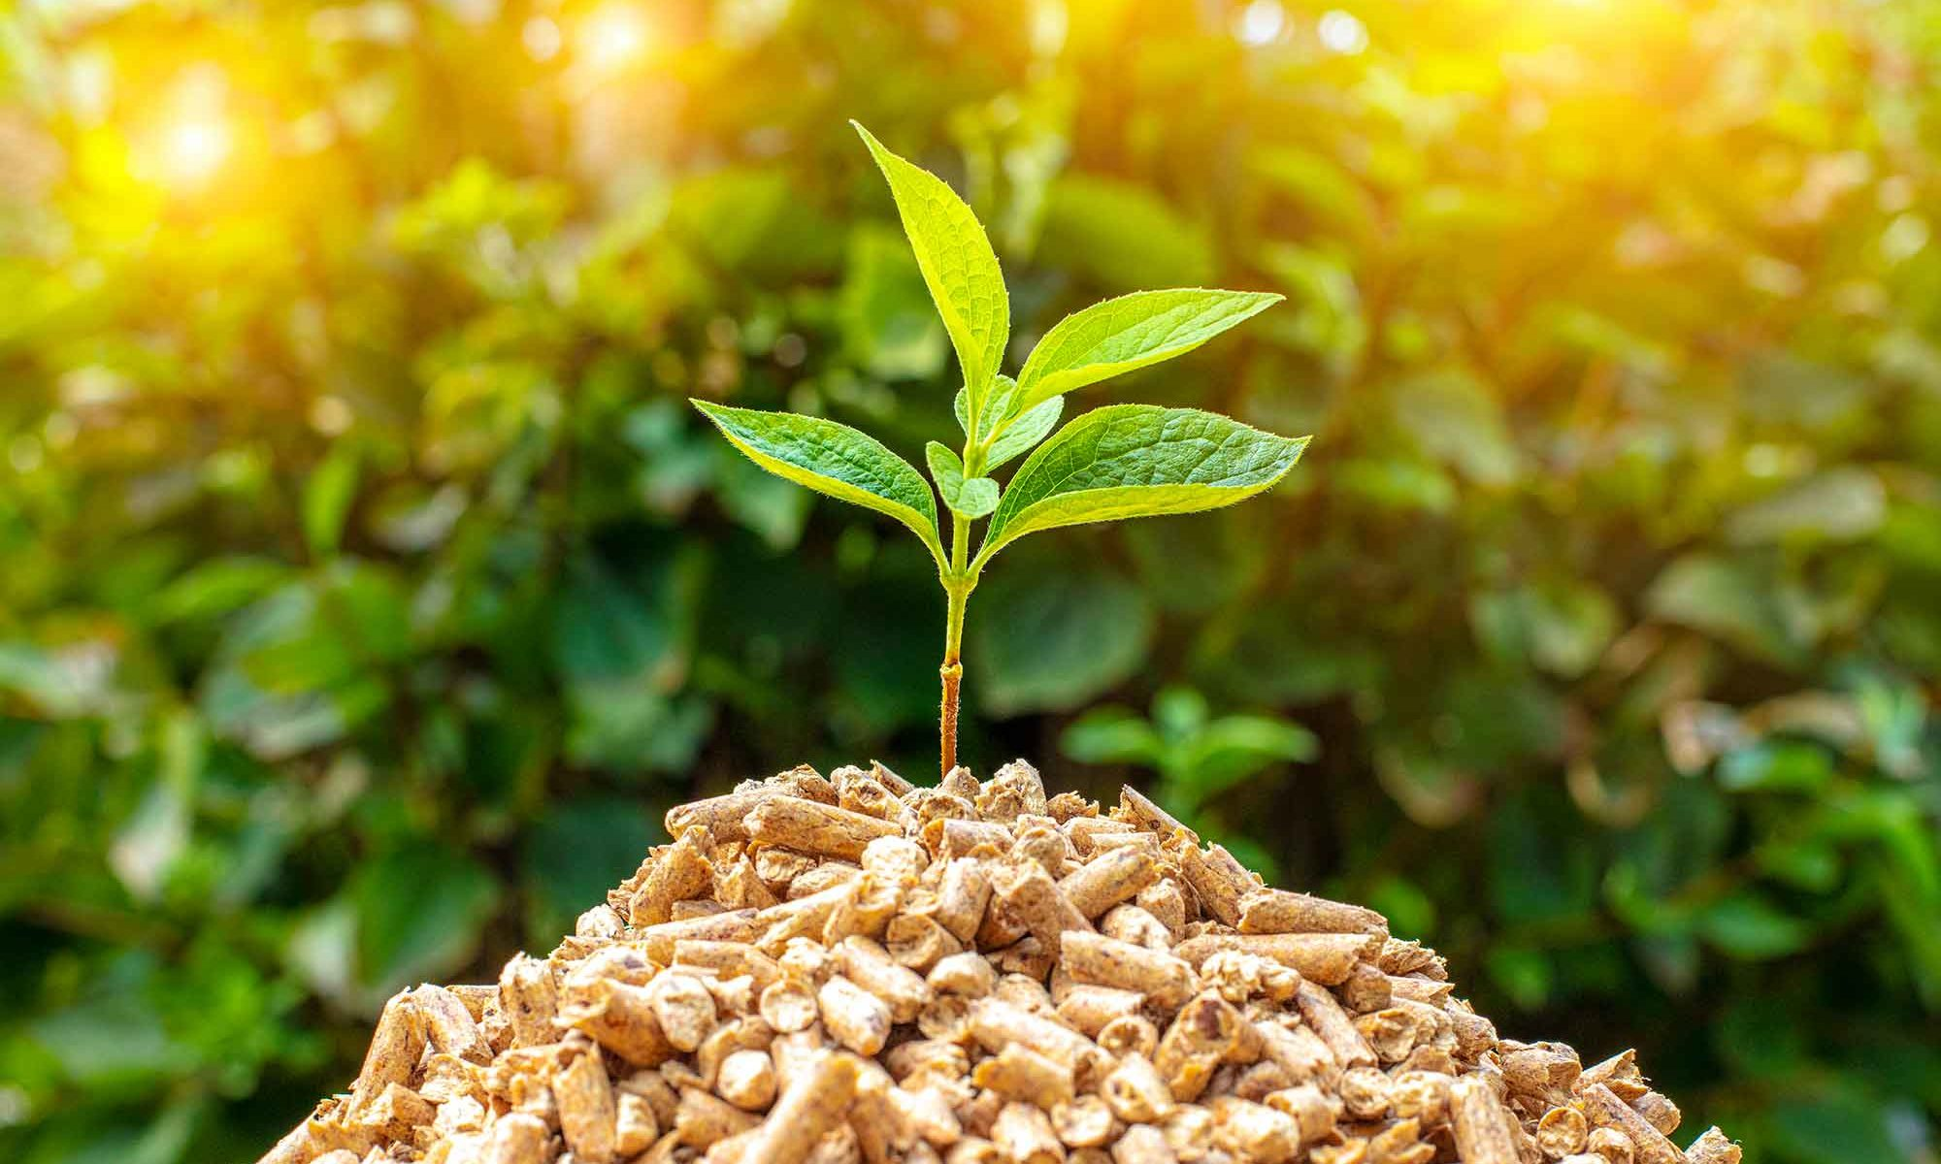
Techno Economic Evaluation of Bio-Oil Production From Biomass
via Fast Pyrolysis
D. Ujwala (CH20B035)
P. Pragathi Sree (CH20B078)
V. Aditya Ram (CH20B114)

Slide 2
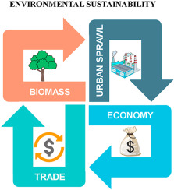
MOTIVATION
Harmful potential of non-renewable energy consumption: search for alternatives
Burning of agricultural residues adds to atmospheric CO2
Diversifying energy sources enhances energy security
Biomass conversion process has potential for job creation & Rural development
Marketable bio-oil plants are scarce because of the complex operations and lower economic profits.
Hence: necessary to comprehend the relationship between technological parameters and economic practicality.

Slide 3

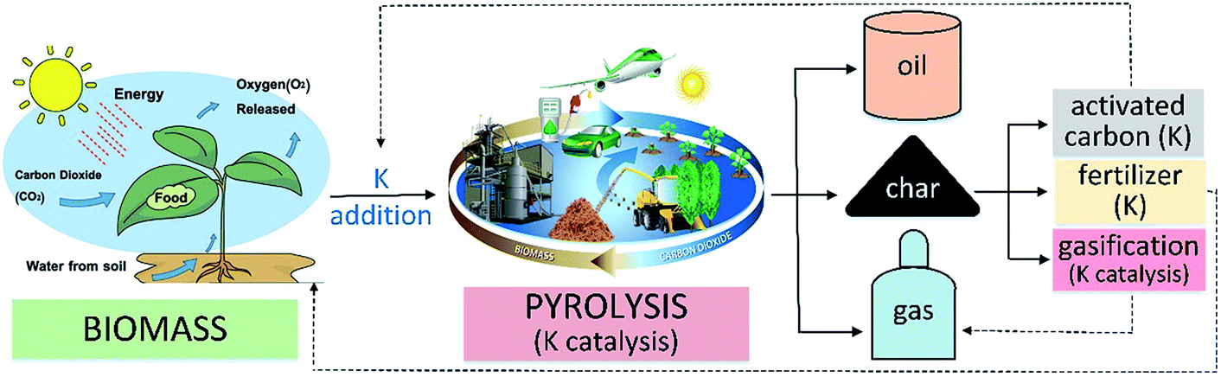
INTRODUCTION - Biomass Pyrolysis
One of the beneficial sources of sustainable bio-oil production.
Most promising thermal decomposition method for the conversion of biomass into valuable bio-products.
An effort to maximize liquid product yield from solid biomass.
Explicit pointers were compared, such as production cost, capacity, and biomass type for bio-oil production.
The commercial practicability of bio-oil is based on
reducing the manufacturing cost
enhancing the product quality, and
improving accessibility to an abundant and sustainable source of biomass.

Slide 4
Most promising approach to generate bio-oil, at its maximum extent
Fertilizer, Activated Carbon
Slow Pyrolysis (Torrefaction)
Biochar
Chemical
BIOMASS PYROLYSIS
Fast Pyrolysis
Engine
Bio-oil
Electricity
Boiler
Combined Heat & Power Plants (CHP)
inert atmosphere; medium temperature 400-600 ⁰C short residence time 2–10 s higher heating rates
Thermal decomposition of organic materials in the complete or near absence of oxygen.
Syn-gas
Heat
Turbine
CO₂ , CH₄
Catalytic Fast Pyrolysis
Bio-oil is the main product (50-70 % weight of the biomass)
Catalytic Hydro-pyrolysis
$$CH_{1.48}O_{0.67}\underset{→}{500 °C, 1s}0.71CH_{1.98}O_{0.76}+0.21CH_{0.1}O_{0.15}+0.08CH_{0.44}O_{1.23}$$
Biomass
Bio-Oil
Char
Gases

Slide 5
Pyrolysis of Bio-Mass
Sample | Reactor | Temperature Range | Bio-oil Yield
Palm kernel Cake | Bubbling fluidized bed reactor | 350-600⁰C | 63% at 401⁰C
Prosospis juliflora | Continuous blade type reactor | 350-800⁰C | 50.2% at 250⁰C
Sawdust, Empty fruit bunch, Miscanthus | Circulating fluidized bed reactor | 400-600⁰C | 60% at 500⁰C
Pomegranate marcs (PM) and grape marcs (GM) | Fixed bed reactor | 400-600⁰C | 43.7% at 500⁰C
Rape straw | Continuous bubbling fluidized bed reactor | 450-550⁰C | 41.39% at 480⁰C
Sugarcane bagasse | Batch pyrolysis reactor | 653-1053 K | 50.89% at 753 K
Sewage sludge | Conical spouted bed reactor | 450-600⁰C | 77% at 500⁰C
Saccharine japonica alga | Fixed-bed reactor | 350-550⁰C | 40.19% at 500⁰C
Corn cob, Corn Stover, Sawdust Rice straw | Microwave-assisted reactor | 400-500⁰C | 42.1%
Pinewood, oak wood, rice husk | Rotating cone reactor | 550-700 ⁰C | 70%
Feedstock: Cotton Stalk;
Reactor: Fixed Bed Reactor
Observed: Influence of temperature and amount of catalyst
The bio-oil yield was higher between 500 and 600 ⁰C despite using different types of biomass and reactors.
The results showed that the percentage of ketone in bio-oil increases as the amount of CaO in catalyst increases.
Furthermore, as the temperature was increased above 600°C, the amount of bio-oil decreased, and the gaseous product increased.
The amount of bio-oil produced depends on
type of reactors
biomass sample being used
operating conditions

Slide 6
Economic Analysis Of Bio-oil Production
Economic analysis involves checking or testing the economic practicability of a process, which helps track future research, expansion, and investment.
Economic analysis is based on methods, size of the plants (laboratory, pilot, or commercial), availability, and continuous feedstock supply.
Total Product Cost
Total Capital Investment
Total Direct Production Cost
Feedstock
Utility Cost
Working Capital
Fixed Capital Investment
Manufacturing FCI (Direct cost)
Non-Manufacturing FCI (Indirect cost)

Slide 7
Techno-Economic Analysis Of Bio-oil Production
The final percentage yield of bio-oil is one of the most substantial constraints affecting process economics.
The maximum bio-oil yield: pine, minimum yield: switchgrass.
Techno-economic analysis (TEA) was performed on the cotton-stalk derivatives. It was concluded that the production capacity could reach approximately 18,000 tons per year with a total manufacturing cost of $3/kg.
The research was conducted to determine the potential economic use of rice straw in thermochemical conversion techniques. The results showed that bio-oil production through pyrolysis from rice straw is economically viable.
Sample | Plant size or Feed rate | Process | Economic Analysis
Pine Tulip Poplar Hybrid Poplar Switch Grass Corn Starch Oriented Strand Board | 2000 tons per day | Bubbling Fluidised bed reactor pyrolysis oil upgrading | Capital Cost: 30% Feedstock cost: 30% Hydrotreating catalyst cost: 13-18% Labor cost: 12-15%

Slide 8
Techno-Economic Analysis Of Bio-oil Production
Sample | Plant size or Feed rate | Process | Economic Analysis
Forest Residue | 5kg/hr | Continuous rotatory kiln reactor | Minimum selling price of upgraded bio-oil was more than double that of crude oil
Corn cob | 96.5 ton per hour | Fluidised bed reactor and hydrotreating | Least tolerable product prices for economic feasibility of pyrolysis route $1.47/gasoline-gallon-equivalent bio-oil.
Rice Husk | 1000 tons per day | Fluidised bed reactor fast pyrolysis | Least bio-oil selling was intended as $0.55/L
Wheat Straw Corn Cob Saw Dust | 100kg/h | Internally interconnected fluidized bed reactor and pretreatment unit | Mobile pyrolysis system has better long term economy than fixed plant due to higher turnover
Eucalyptus | 2000 metric ton per day | TGRP and electricity generation plant | Pyrolysis of eucalyptus for power in a single facility is not good with current electricity cost
Sugarcane bagasse | 10 tons per hour | Pyrolysis reactor and hydrotreating | Fluctuating tax chargers and capital costs cannot disturb the least selling price as much as conversion rates

Slide 9
Bio-oil Production Cost and Analysis
Economic Analysis
determine the investment required to run a plant every year and the production cost of bio-oil
Capital Cost
Cash Flow Analysis
Operations cost, payback period, break-even analysis examine the link b/w est. project cost and the rate of return
calculate metrics: net present value and internal rate of return
typically incorporate financial parameters (taxes, discount rates)
The sale of by-products produced in biomass pyrolysis, such as biochar, can reduce the bio-oil production cost by 18%.
Sensitivity & Uncertainty Analysis
Dependent on the fluctuations of the price rate of different parameters such as feedstock, labor, electricity, taxes, and total plant running time
Economic Performance
the increase or improvement in the market value
Product Cost Compatibility with Existing Fuel Cost
production cost of bio-oil compared with fuel produced from other sources and methods

Slide 10
Bio-oil Production Cost and Analysis
Bio-oil production cost from the fast pyrolysis of 2000 tons per day woodchips is 1.09 $/L.
They also tested the feasible plant size optimization from 500 to 5,000 tons per day and determined that a 3,000 tons per day capacity is well suited based on economic analysis.
Source of Bio-oil | Capacity | Cost of Bio-oil
Municipal Sewage | 50kg/h | 3.130(euro/kg)
Napier Grass bagasse | 49kg/h | $5.81/gallon ($1.45/L) GGE
Sludge Scum | 3.5 wet tons of scum, 265 dry tons of sludge daily | $1.85/gallon
Horse Manure | 200 metric dry ton/day | ($1.35-$1.8 L^-1) of jet fuel
Pine | 1000 metric dry ton/day | 4.01-6.84 $/gal
Sorghum bagasse, Corn stover, Palm kernel, Switch Grass | 2000 metric tons/day | $2.5-$5/gallon
Beechwood | 500 MT/day | 2.32-3.08$/gallon
Pinewood | 72 MT/day | 6.25 pounds/GGE
Red Oak | 2000 dry MT/day | $3.09/gallon
Microalgae | 2000 MT/day | $ 1.49 & $1.8 per litre

Slide 11
RESULTS
Heat integration application in pyrolysis leads to the sustainability of the process via energy recovery and reduces the overall process’s utilities cost.
The overall pyrolysis process is endothermic, and heat is required to complete the significant reactions. The combustible gases produced as a co-product during fast pyrolysis can also provide the process heat. These approaches reduce the overall utilities and operation cost, which positively affect the bio-oil production cost.
Using a blended feedstock (mixture of two or more different biomass) is beneficial because of the massive variety in biomass selection, lower risk, lower carriage costs and lower operation costs of the process
Bio-fuel upgrading is another suitable technique for making a product commercially feasible. Several kinds of catalysts used for the bio-oil upgradation (N_{i}, zeolite, Al₂O₃, P_{d}, P_{t}, TiO₂, etc)
Catalytic upgrading contributes to the operational cost and can be reduced using a less expensive catalyst.
Furthermore, pyrolysis plants with a higher capacity can produce less expansive bio-oil than smaller plants.
Recycling is another route to enhancing economic potential. Research has been conducted on rape straw, corn stalks, and camphor wood, in which gases produced during the pyrolysis process are recycled.

Slide 12
CONCLUSION
Fast pyrolysis is the most beneficial method to extract bio-oil products from biomass feedstock.
Bio-oil and its properties differ considerably depending on the feedstock configuration and structure, residence time, and temperature. Few reports on economic analysis of the fast pyrolysis process make it commercially stable.
A series of aspects, such as plant life expectancy, raw feed, technological parameters, and biomass price, regulate the economic stability of bio-oil production from fast pyrolysis.
The production cost of bio-oil is the critical factor for evaluating the market compatibility with other biofuels available. The cost can be affected by different pretreatments, upgrading processes, and recycling techniques
The temperature range from 500 to 600 C produces a higher bio-oil yield, reducing overall production cost.
More research has to be done on bio-oil production in terms of the commercial sector’s economic benefits.

Slide 13


Thank
You

